Slide 1
Week 9
Views & Triggers

Slide 2
Views
A view is a virtual table from the result-set of a SQL statement
Views are known as “virtual tables” because a view does not form part of the schema
Views are not stored data – just a stored query
A view is a shortcut to run a query and get back a results table
The virtual table is computed each time access to that view is requested
Views are particularly useful to show frequently used and complex outputs that may request fields from multiple tables
For example, the output table of a complex join statement
Therefore, views are used to answer questions that are asked often by your data users

Slide 3
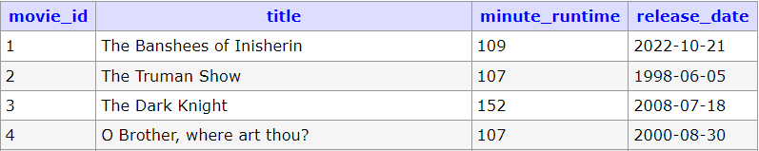
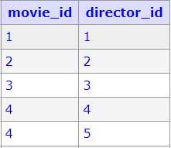
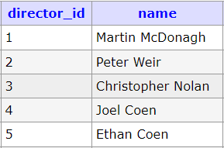
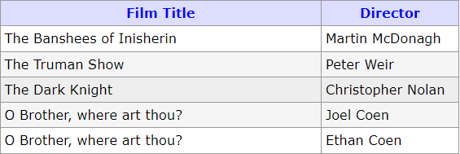
Views / Example
To output movies with their directors, we need to join 3 tables each time
Or we CREATE and SELECT a view for when this output is needed

Slide 4
CREATE VIEW¹
Example: Create a view of all movies coming soon
SELECT m.title, m.release_date, d.name
FROM movie m
INNER JOIN movie_director md ON m.movie_id = md.movie_id
LEFT JOIN director d ON md.director_id = d.director_id
WHERE DATE(m.release_date) > NOW();
CREATE VIEW movie_coming_soon AS
Syntax
CREATE VIEW view_name AS
SELECT column1, column2, ...
FROM table_name WHERE condition;
¹ W3Schools: CREATE VIEW

Slide 5
SELECT View
Example: Select view of all movies coming soon, or movies coming soon in 2024
SELECT * FROM movie_coming_soon;
SELECT * FROM movie_coming_soon
WHERE release_date LIKE '%2024%';
Views should be subsets of data from other tables
Any of the select strategies can be used when querying your view:
Aggregate functions: SUM(), MIN(), MAX(), COUNT()
Keywords: DISTINCT, WHERE, ORDER BY, GROUP BY, LIMIT etc.
Subqueries
These select strategies can be useful to reduce the view result set
Just like select statements, specific queries of views improve query speed

Slide 6
Views / Advantages
Views / Limitations
Simplifies complex queries
Reusability: Save frequently used queries as views for easy reference
Protect data: An extra layer of security to limit or restrict data access
UPDATE, INSERT and DELETE can be used with some views but not recommended
It is sometimes recommended to not use aggregate functions, GROUP BY, HAVING, and DISTINCT with views for these reasons:
Performance issues: High resource consumption & Inefficiencies without indexes
Maintenance complexity: Difficult to debug and update
Limiting the flexibility of queries to the view

Slide 7
ALTER VIEW
DROP VIEW
A view can use ALTER keyword to change the views query
Syntax
ALTER VIEW view_name AS
SELECT column1, column2, ...
FROM table_name WHERE condition;
A view can be deleted with the DROP keyword
Syntax
DROP VIEW view_name;

Slide 8
Triggers
Triggers are SQL scripts that run when a DML (Data Manipulation Language) event occurs
These DML events include changes in table structure or when data is manipulated using INSERT, UPDATE or DELETE statements
Triggers execute in response to a specific event on a specified table
For example, trigger a SQL script to run after a new value is inserted into a table
Using SQL, DB developers can create both the trigger script and determine when the trigger script should run
Similar to JavaScript html element events
An event occurs -> code runs in response to the event

Slide 9
Triggers
Syntax
CREATE TRIGGER trigger_name
[ BEFORE | AFTER ] [ INSERT | UPDATE | DELETE ]
ON table_name
FOR EACH ROW
-- Trigger Body, AKA SQL statements to run when event triggered;
Notes:
Start with CREATE TRIGGER statement and name the trigger. A way to name a trigger is description + event such as INSERT/UPDATE/DELETE so it is clear what the trigger does.
BEFORE/AFTER refers to when the trigger will occur – whether it is before or after an event INSERT, UPDATE or DELETE.
FOR EACH ROW means that each row is being updated when the trigger runs.
Trigger body refers to the SQL statements to be executed when the trigger is activated.

Slide 10
Trigger Events
Triggers can be created to run BEFORE or AFTER any of these SQL commands are run
Trigger Event | OLD | NEW
INSERT | No | Yes
UPDATE | Yes | Yes
DELETE | Yes | No
For an INSERT trigger
OLD contains no values
NEW contains the new values being inserted
For an UPDATE trigger
OLD contains the old values that are being replaced
NEW contains the new values that are replacing the old values
For a DELETE trigger
OLD contains the old values that are being deleted
NEW contains no values

Slide 11
Triggers / BEFORE & AFTER
Before triggers can be used to validate or change before they are inserted in the database tables
Like checking more complicated inputs
Or changing values to meet a specific format required in the table
After triggers are used when data modifications need to be completed and available in tables first
Like if you want to reference the new data in a different table using a foreign key

Slide 12
Triggers
Example: When a user leaves a review for a movie, update their last_review_id column to hold the id of the most recent review by the user
INSERT INTO review (username, rating, movie_id, content)
VALUES ('humber_bebis',4.5,1,"This movie rocks!");
Insert Trigger Event
AFTER INSERT
UPDATE user
SET last_review_id = NEW.review_id
WHERE username=NEW.username;
run trigger script

Slide 13
Triggers
Example: When a user leaves a review for a movie, update their last_review_id column to hold the id of the most recent review by the user
CREATE TRIGGER update_after_latest_review
AFTER INSERT ON review
FOR EACH ROW
UPDATE user
SET last_review_id = NEW.review_id
WHERE username=NEW.username;
Trigger Event Type
Trigger body run after each row is inserted

Slide 14
Triggers / Multiple Statements - DELIMITER
Example: When a user leaves a review for a movie, update their last_review_id column to hold the id of the most recent review by the user AND update the review with a timestamp
CREATE TRIGGER update_after_latest_review
AFTER INSERT ON review
FOR EACH ROW
UPDATE user
SET last_review_id = NEW.review_id
WHERE username=NEW.username;
DELIMITER //
BEGIN
UPDATE review
SET last_update = NOW()
WHERE review_id=NEW.review_id;
END//
DELIMITER ;
Trigger Event Type
Trigger body can run Multiple statements after each row is inserted
To use multiple statement we must change delimiter from ; to // allowing us to use the semicolon delimiter in our trigger body
Notes:
DELIMITER:
A DELIMITER is required when there are multiple statements in the body. The role of the DELIMITER is to indicate where one statement ends and where the next one begins. For MySQL, the semi-colon is the default delimiter. However, when there are multiple statements, we need a way to group the statements together so that the SQL runs all the statements. This is where the DELIMITER steps in. By setting a custom DELIMITER such as // or $$ (in place of the semi-colon ; ), we can define the block of code. Inside that code body, you can use semi-colons freely after.

Slide 15
Triggers
Example: When a user leaves a review for a movie, update their last_review_id column to hold the id of the most recent review by the user
CREATE TRIGGER update_after_latest_review
AFTER INSERT ON review
FOR EACH ROW
UPDATE user
SET last_review_id = NEW.review_id
WHERE username=NEW.username;
INSERT INTO review (username, rating, movie_id, content)
VALUES ('humber_bebis',4.5,1,"This movie rocks!");
UPDATE user
SET last_review_id = NEW.review_id
WHERE username=NEW.username;
NEW.review_id = 1
NEW.username = 'humber_bebis'

Slide 16


Triggers / FOR EACH ROW
Example: When a user leaves a review for a movie, update their last_review_id column to hold the id of the most recent review by the user
INSERT INTO review (username, rating, movie_id, content)
VALUES ('humber_bebis',4.5,1,"This movie rocks!");
Insert Trigger Event
AFTER INSERT
UPDATE user
SET last_review_id = NEW.review_id
WHERE username=NEW.username;
run trigger script

Slide 17
Triggers / Advantages
Triggers / Disadvantages
Database integrity: Triggers provide an extra layer of checks for data integrity
Example: Invalid data will be prevented from being inserted or updated into the database
Auditing data changes
Triggers are useful for logging any changes in table data
Scheduled tasks
Triggers can automatically run scheduled tasks
Triggers do not provide any feedback to the database user, so you will not be notified if there is an issue, Triggers do things quietly
Difficult to troubleshoot because triggers run automatically

Slide 18
DROP TRIGGER
A trigger can be deleted with the DROP keyword
To alter a trigger it is recommended to drop the trigger and recreate it, or use this syntax:
Syntax
DROP TRIGGER trigger_name;
Syntax
CREATE OR REPLACE TRIGGER trigger_name
[ BEFORE | AFTER ] [ INSERT | UPDATE | DELETE ]
ON table_name
FOR EACH ROW
-- Trigger Body, AKA SQL statements to run when event triggered;

